Slide 1
Notes:
Display for the class as they transition to this lesson.

Slide 2
Notes:
Ask: How could this be? Activate prior knowledge by having students recall sales receipts they’ve seen. Have they ever bought an item and found there was an extra cost?

Slide 3
Notes:
Introduce the concept of sales tax by showing this sample receipt. Point out the subtotal and tax lines, and explain that sales tax is a percentage of the price that is added to the original cost. Each state decides how much sales tax to charge on certain items; states use the money to pay for public services like roads and schools. Some states also have city or other local sales taxes added to the state sales tax.

Slide 4
Notes:
Use the examples on the slide to demonstrate how to calculate sales tax from different states. Fill in the sales tax amount and total cost.
Answer Key:
Sales Tax Amount Rounded Amount
$25 ✕ 0.04225 = $1.06 $26.06
$25 ✕ 0.07 = $1.75 $26.75
$25 ✕ 0.0945 = $2.36 $27.36

Slide 5
Item | Item Cost | Sales Tax % | Sales Tax Amount | Total Cost
Video game | $39.00
Set of markers | $11.00
Skateboard | $55.00
Set of books | $44.00
Notes:
Work together as a class to complete the chart. To determine the sales tax percent, roll a die (so you'll be working with anywhere between 1% and 6%). Have calculators available so students can figure out the tax amount on their own, and then check to see if they got it right.

Slide 6
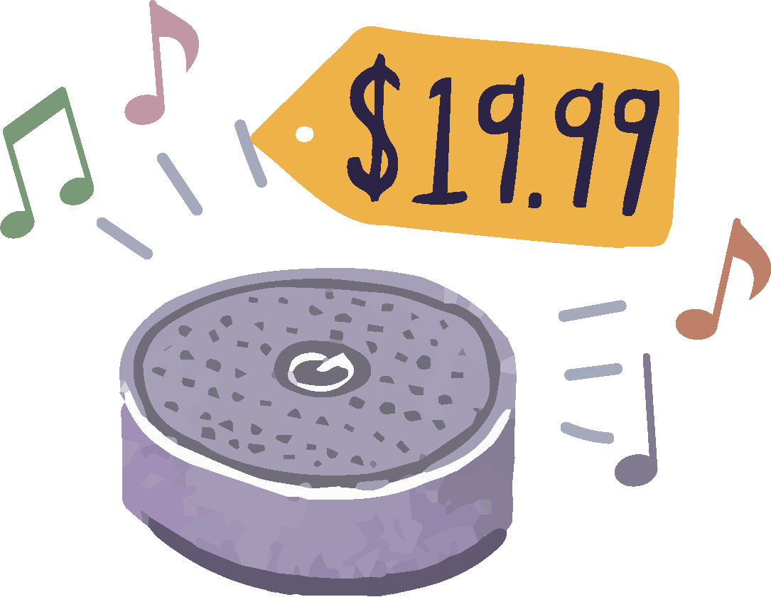
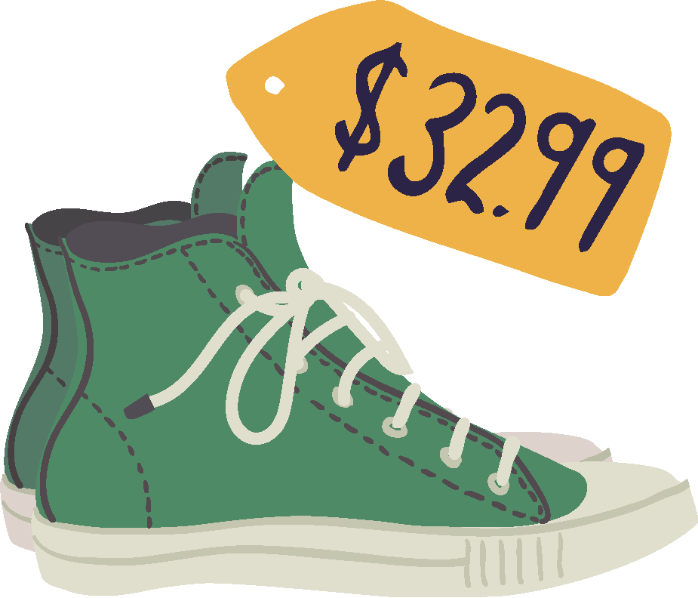
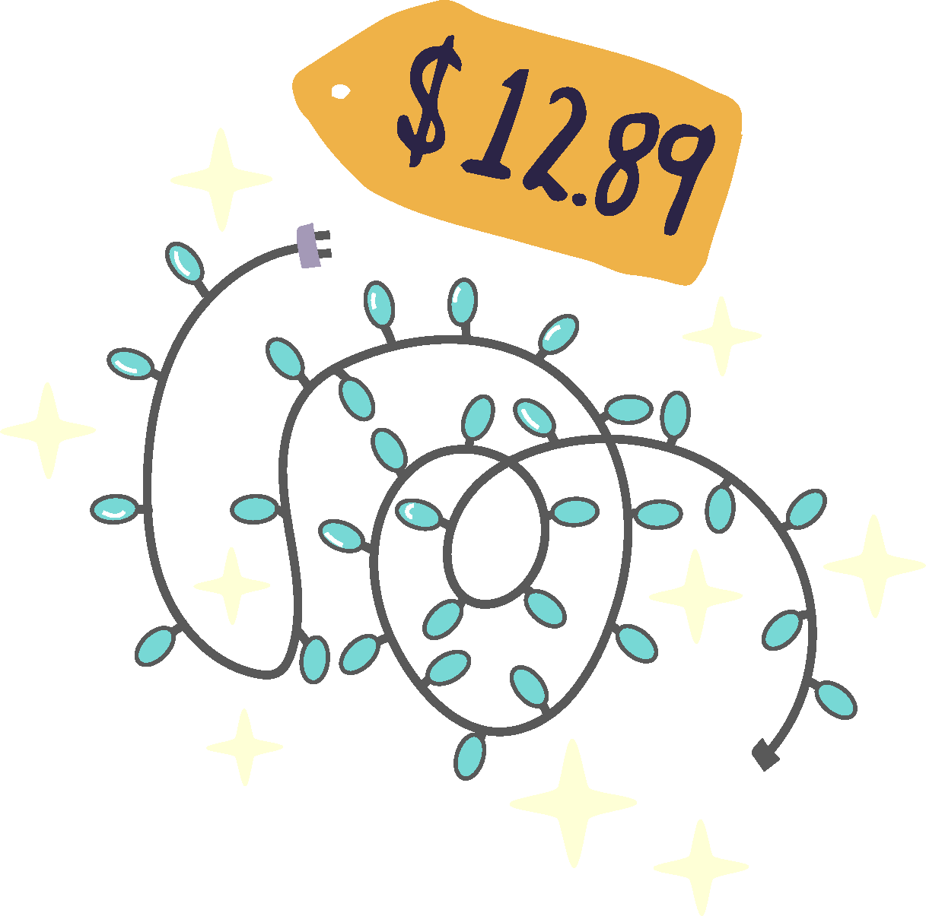
Notes:
Tell students: You earned $50 babysitting and you've decided to treat yourself! Pick out what you want from the items on the slide, but remember to figure in sales tax. Select your items, calculate the sales tax [Instructor: use your local rate], and figure out your grand total. Remember: Keep it under 50 bucks!
Have students do their work in journals or in their own copy of this Google Slide deck. If using the latter, they can drag and drop items into the tote bag on the slide.

Slide 7
Notes:
Blank slide for students to do their calculations.

Slide 8
Notes:
Invite students to discuss these questions with a partner or in small groups. Come back together as a whole group and ask: For every dollar, sales tax adds __ cents in our city, so what amount is added for every $10? (Remember, if sales tax is 5%, that means $0.05 for every dollar.) When we know the tax amount paid (say, $21), how can we use proportional reasoning to find the original cost? In your discussion, make sure to surface these tips for students:
Use mental math to quickly find 1% of a number: Move the decimal point two spaces to the left, which is equivalent to dividing the number by 100. Once you have 1%, you can double it to find 2%, etc.
To double-check that you’re moving the decimal in the correct direction, remember that you want to end up with a number that is smaller than the original number, since 1% is just a small amount of the whole.

Slide 9
Click to write your answer
Notes:
Assess student understanding with an exit ticket. Read the scenario to the class and ask: Does this seem reasonable? Have students respond in journals or in their own copy of this Google Slide deck. Encourage them to write a sentence on whether this “feels right” using mental math, and how the clerk should fix the error.
Answer Key: Sales tax on $10 is $0.50, but the clerk made a place value error and added $5 to the subtotal. The correct total is $10.50.

